Slide 1
DATA ANALYTICS(MR22-1CS0110)
III Year B. Tech – II Semester
(2024-2025)
COURSE OBJECTIVES:
Learning about the Importance of Data and its importance.
Knowing Python fundamentals and Pandas essentials.
Learning the Principles of Probability and sampling Methods.
Getting knowledge about formulating and testing hypothesis.
Learning and analytical comparison’s with ANOVA methods.
Learning about Performance indicators using ROC methods.
Reference Books:
1.McKinney, W. (2012). Python for Data Analysis: Data Wrangling with Pandas, NumPy, and IPython. O'Reilly Media, Inc.
2.Swaroop, C. H. (2003). A Byte of Python: Python Tutorial.
Black, K. (6th ed.). Business Statistics for Contemporary Decision Making. John Wiley & Sons, Inc.
3.Anderson, D. R., Sweeney, D. J., & Williams, T. A. (2011). Statistics for Business and Economics. Cengage Learning.

Slide 2
UNIT- I
Part-1 | Part-2 | Part-3
0.Introduction to Data Analytics: Data and its importance Data analytic and its types Importance of data analytics | Python Fundamentals: Python Language Basics Jupyter Notebook Introduction to pandas Data Structures Essential Functionality | Central Tendency and Dispersion: Visual Representation of the Data Measures of Central Tendency & Dispersion

Slide 3
0.Introduction to Data Analytics:
Data analytics is the process of examining, cleaning, transforming, and modeling data with the goal of discovering useful information, drawing conclusions, and supporting decision-making.
It involves the application of statistical, mathematical, and computational techniques to derive insights and inform business strategies, scientific research, and policy-making.
Simply it Is the process of exploring and analyzing large datasets to make predictions and boost data-driven decision making.
It involves the use of various techniques, tools, and technologies to analyze and interpret large sets of data, uncover patterns, trends, and insights, and make informed business or research decisions.
In today’s data-driven world, data analytics plays a crucial role across various sectors, including business, healthcare, finance, sports, and more. As the amount of data generated continues to increase, the need for effective data analytics methods has never been more critical.

Slide 4
Key Concepts in Data Analytics:
Data Collection: The process of gathering raw data from various sources like databases, surveys, sensors, or online platforms. This step ensures that the right data is collected for analysis.
Data Cleaning: Raw data is often messy, containing inconsistencies, missing values, and errors. Data cleaning (or data wrangling) is the process of transforming raw data into a structured, usable format. This step is crucial to ensure the accuracy and quality of the analysis.
Data Exploration and Visualization: This phase involves exploring the data to identify patterns, trends, and outliers. Visualization tools like charts, graphs, and dashboards are used to present data in an understandable format, making it easier to interpret and analyze.
Data Analysis and Modeling: In this phase, statistical and machine learning techniques are applied to the cleaned data to build models, test hypotheses, and derive insights. This may involve predictive modeling, classification, regression, or clustering techniques, depending on the problem at hand.
Interpretation and Decision Making: The final step involves interpreting the analysis results and making informed decisions based on the insights gained. This may involve making recommendations, forecasting trends, or developing strategies to address business problems.

Slide 5
Types of Data Analytics:
Descriptive Analytics: Focuses on understanding what has happened by summarizing historical data. Common techniques include mean, median, mode, and standard deviation. Descriptive analytics is typically used to assess past performance.
Diagnostic Analytics: Goes a step further to understand why something happened. It uses techniques like correlation and regression analysis to identify the root causes of trends or events.
Predictive Analytics: Uses historical data and statistical algorithms to predict future outcomes. Predictive models can help organizations forecast demand, customer behavior, or market trends.
Prescriptive Analytics: Recommends actions or strategies for achieving desired outcomes. It uses optimization algorithms and simulations to provide actionable advice and help decision-makers choose the best course of action.

Slide 6
Tools and Technologies Used in Data Analytics:
Programming Languages: Python, R, SQL
Data Visualization Tools: Tableau, Power BI, matplotlib, Seaborn
Statistical and Machine Learning Libraries: Pandas, NumPy, Scikit-learn, TensorFlow, PyTorch
Data Management Platforms: Excel, Google Sheets, Hadoop, Spark
Applications of Data Analytics:
Business: Informed decision-making, customer insights, market segmentation, supply chain optimization.
Healthcare: Disease prediction, patient care management, drug development.
Finance: Risk analysis, fraud detection, investment strategies.
Sports: Player performance analysis, game strategy optimization.
Government: Policy development, economic forecasting, public health monitoring.

Slide 7
1.Data and its importance
Data refers to raw facts and figures that, when processed, analyzed, or organized, can provide valuable insights.
It plays a central role in various fields, from business and technology to science and healthcare, driving decision-making and innovation.
Here's an overview of its significance:
1. Foundation for Decision-Making
In Business: Data drives strategic decisions, helping companies to understand customer preferences, optimize operations, and predict market trends. For instance, sales data allows companies to tailor their marketing efforts and inventory management.
In Government: Policy decisions are often based on statistical data, such as census results or economic indicators, to shape national or local governance.
2. Improving Efficiency and Productivity
Organizations use data to streamline processes, identify inefficiencies, and enhance resource allocation. For example, manufacturing industries employ data analytics to monitor machine performance and predict maintenance needs.
In agriculture, data on weather patterns, soil conditions, and crop yields can optimize farming practices and increase food production.

Slide 8
3. Innovation and Technological Advancement
Data fuels innovation, especially in fields like artificial intelligence (AI), machine learning, and big data analytics. By processing large datasets, machines can learn patterns and improve performance without explicit programming.
Data-driven research is essential in medicine to discover new treatments, understand diseases, and improve patient care.
4. Personalization and User Experience
Data enables personalized experiences in various digital platforms. For instance, social media platforms, e-commerce websites, and streaming services use data to recommend content or products based on user preferences and behaviors.
In education, data-driven insights help tailor learning experiences to individual student needs, improving outcomes.
5. Risk Management
Financial institutions use data to assess credit risk, detect fraud, and manage investments.
Similarly, in insurance, data analysis helps in determining premiums and assessing risk.
In healthcare, patient data can predict medical risks and outcomes, enabling proactive care and minimizing emergencies.

Slide 9
6. Competitive Advantage
Data provides businesses with insights into market trends, customer behaviors, and competitor performance. Organizations that harness and analyze data effectively can gain a competitive edge, enhancing their products and services.
7. Data as a Commodity
In the modern economy, data itself has become a valuable commodity. Companies like Google, Amazon, and Facebook rely on the collection, analysis, and sale of data to fuel their business models.
This has raised concerns about privacy, as vast amounts of personal data are constantly being collected and analyzed.
Conclusion on why data is important :
Data is essential for informed decision-making, continuous improvement, and innovation across industries. With the growing importance of digital transformation, the ability to manage, interpret, and utilize data is crucial for success in today’s fast-paced world.

Slide 10
2.Data analytic and its types
What is Data Analytics.
Understanding Data Analytics.
Types of Data Analytics.

Slide 11
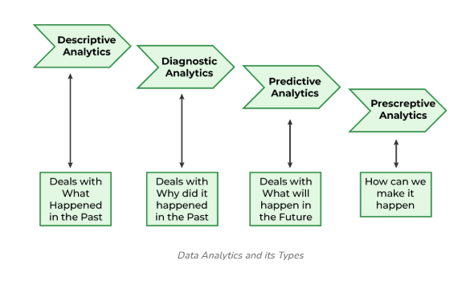
What is Data Analytics.
we can say that data analytics is the process of manipulating data to extract useful trends and hidden patterns that can help us derive valuable insights to make business predictions.
Understanding Data Analytics
Data analytics encompasses a wide array of techniques for analyzing data to gain valuable insights that can enhance various aspects of operations.
For instance, in manufacturing, companies collect data on machine runtime, downtime, and work queues to analyze and improve workload planning, ensuring machines operate at optimal levels.
Types of Data Analytics
There are four major types of data analytics:
Descriptive (business intelligence and data mining)
Diagnostic analytics
Predictive (forecasting)
Prescriptive (optimization and simulation)

Slide 12

1. Descriptive Analytics
Descriptive analytics answers the question, "What happened in the past?" It focuses on summarizing past data and providing insights into historical performance. The goal is to describe the characteristics of the data in a way that is easy to understand.
This type of data analytics helps them compare past results, identify anomalies, distinguish strengths and weaknesses, etc. Companies use descriptive analysis to identify a problem.
Examples:
Sales reports
Website traffic statistics
Customer satisfaction scores
Methods Used:
Data aggregation
Data visualization (e.g., graphs, pie charts, histograms)
Summary statistics (e.g., mean, median, mode)
Bar Chart showing monthly sales over the past year.

Slide 13
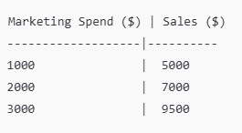
2. Diagnostic Analytics
Diagnostic analytics answers the question, "Why did it happen?" It goes beyond simple description to identify the causes or reasons behind a particular outcome. This type of analysis helps in understanding the factors that contributed to the result.
Results from this type of analytics help companies draft accurate solutions to problems instead of relying on guesswork.
Examples:
Analyzing why sales decreased in a certain quarter.
Identifying why a marketing campaign was unsuccessful.
Methods Used:
Root cause analysis
Correlation analysis
Drill-down analysis
Scatter Plot showing the relationship between marketing spend and sales performance.

Slide 14

3. Predictive Analytics
Predictive analytics answers the question, "What is likely to happen in the future?" It uses historical data, statistical algorithms, and machine learning techniques to predict future trends and behaviors. This type of analysis helps in making forecasts about potential outcomes.
Examples:
Forecasting sales for the next quarter.
Predicting customer churn.
Methods Used:
Regression analysis
Time-series forecasting
Machine learning models (e.g., decision trees, neural networks)
Line Graph showing a forecast of sales growth for the next 6 months based on historical data.

Slide 15
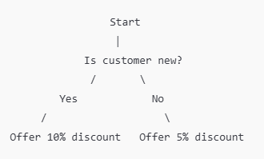
4. Prescriptive Analytics
Prescriptive analytics answers the question, "What should we do?" It provides recommendations for optimal decision-making by analyzing data and suggesting actions that can lead to the best possible outcome.
Examples:
Suggesting the best price point for a product based on market conditions.
Recommending the best marketing strategy to increase sales.
Methods Used:
Optimization algorithms
Simulation models
Decision analysis
Decision Tree illustrating various decisions based on certain conditions (e.g., customer type, purchase history).

Slide 16
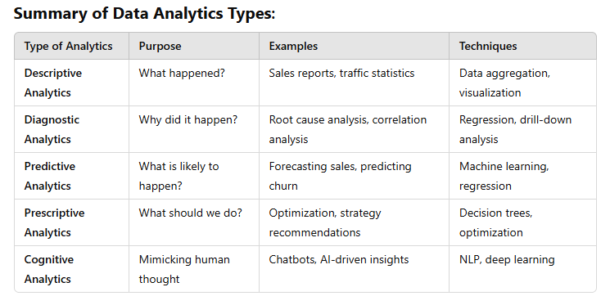

Slide 17
3.Importance of data analytics
Data analytics is important to understand trends and patterns from the massive amounts of data that are being collected. It helps optimize business performance, forecast future results, understand audiences, and reduce costs.
Reducing inefficiencies and streamlining operations: Data analysis identifies inefficiencies and bottlenecks in business processes, providing opportunities to mitigate them. By analyzing resource and process data, organizations can find ways to reduce costs, boost productivity, and save time.
Driving revenue growth: Data analysis promotes revenue growth by optimizing marketing efforts, product development, and customer retention strategies. It enables a focused approach to maximizing returns on investment (ROI).
Mitigating risk: Forecasting potential issues and identifying risk factors before they become problematic is invaluable for all kinds of organizations. Risk analysis provides the foresight that enables businesses to implement preventative measures and avoid potential pitfalls.
Enhancing decision-making: Insights from analyzing data empower informed, evidence-based choices. This shifts decision-making from a reliance on intuition to a strategic, data-informed approach.
Lowering operational expenses: Data analysis helps identify unnecessary spending and underperforming assets, facilitating more efficient resource allocation. Organizations can reduce costs and reallocate budgets to improve productivity and efficiency.
Identifying and capitalizing on new opportunities: By revealing trends and patterns, data analysis uncovers new market opportunities and avenues for expansion. This insight allows businesses to innovate and enter new markets with a solid foundation of data.
Improving customer experience: Analyzing customer data helps organizations identify where to tailor their products, services, and interactions to meet customer needs, enhance satisfaction, and foster loyalty.

Slide 18
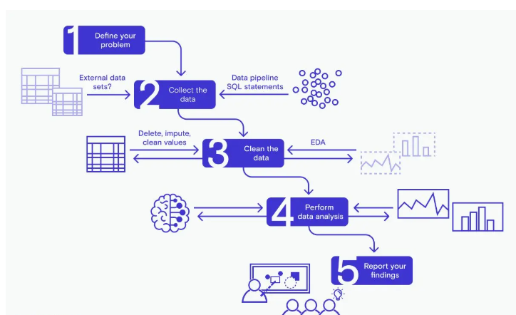
Step-by-Step Process That Data Analysts Follow in Their Workflow

Slide 19
Step-by-Step Process That Data Analysts Follow in Their Workflow
Summary of the Data Analyst Workflow:
Define the Problem or Objective
Data Collection
Data Cleaning (Preprocessing)
Data Exploration and Analysis (EDA)
Hypothesis Testing and Statistical Analysis
Data Modeling and Predictive Analytics
Data Interpretation and Insights Generation
Data Visualization
Communicate Results
Implement and Monitor Results

Slide 20
Part-2::Python Fundamentals:
4.Python Language Basics
5.Jupyter Notebook
6.Introduction to pandas
7.Data Structures
8.Essential Functionality

Slide 21
Python Language Basics
4.1 Variables and Data Types
4.2 Lists, Tuples, and Dictionaries
4.3 Conditional Statements (if, elif, else)
4.4. Loops
4.5 Functions

Slide 22
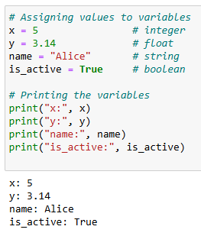
Python Fundamentals for Data Analytics
Python is widely used for data analytics because of its simplicity and the rich ecosystem of libraries it offers. Below, we'll cover the basic concepts and tools that are essential for data analytics in Python.
4.1 Variables and Data Types
Python has several built-in data types that are commonly
used in data analytics:
int: Integer numbers, e.g., 1, 100, -5.
float: Floating-point numbers, e.g., 3.14, -0.001, 2.0.
str: Strings (text), e.g., "Hello", 'Python'.
bool: Boolean values, e.g., True, False.

Slide 23
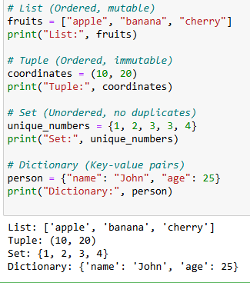
Python Fundamentals for Data Analytics
Python is widely used for data analytics because of its simplicity and the rich ecosystem of libraries it offers. Below, we'll cover the basic concepts and tools that are essential for data analytics in Python.
4.2 Lists, Tuples, and Dictionaries
List: Ordered, mutable collection and allows duplicates &
list do not need to be of the same type.
List = [1, 2, 3, "GFG", 2.3]
print(List)
Tuple: Ordered, immutable collection.i.e. the elements in
the tuple cannot be added or removed once created.
Just like a List, a Tuple can also contain elements of various
types.
It will allow negative indexing.
Dictionary: Unordered collection of key-value pairs.
These are mutable
Set:collection of unique elements that do not follow a
specific order.
Unlike tuples, sets are mutable – they can be modified, added, replaced, or removed.

Slide 24
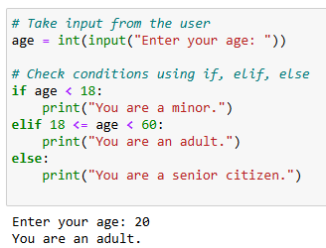
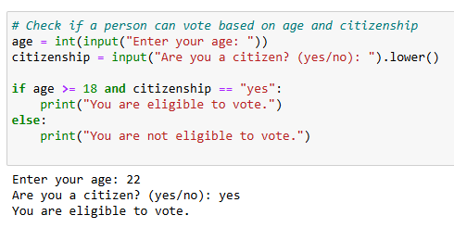
4.3 Conditional Statements (if, elif, else):
Conditional statements allow you to execute certain blocks of code based on whether a condition is true or false.
Example: Using and, or, and not for Complex Conditions

Slide 25
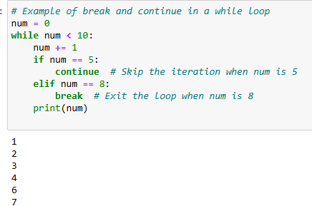
4.4. Loops:
Loops allow you to execute a block of code multiple times.
Example: for Loop (Used for Iterating over Sequences)
Example: for Loop with Range
Example: for Loop with a Start and Step
Example: while Loop (Used for Repeatedly
Executing Code as Long as a Condition is True)
Example: while Loop with Break and Continue

Slide 26
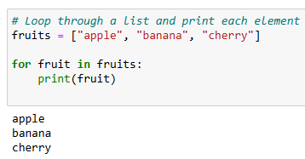
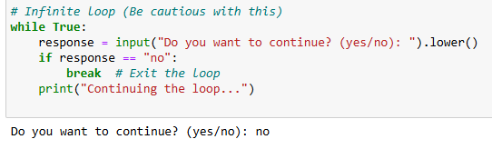
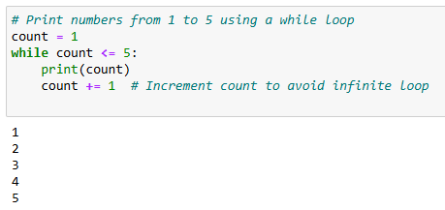
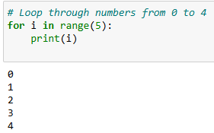
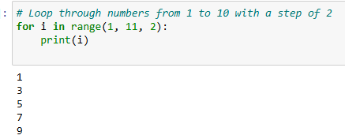

Slide 27
Summary of Conditional Statements and Loops:
if: Executes a block of code if the condition is true.
elif: Allows multiple conditions to be checked.
else: Executes code if none of the if or elif conditions are true.
for: Iterates over a sequence (like a list, string, or range).
while: Repeats code as long as a condition is true.
break: Exits the loop immediately.
continue: Skips the current iteration and proceeds with the next one.
pass: A placeholder that does nothing.
These structures are fundamental to controlling the flow of your programs in Python

Slide 28
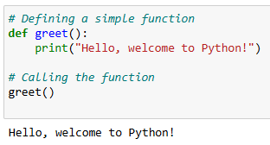
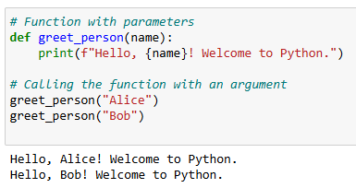
4.5 Functions: in Python allow you to organize your code into reusable blocks. Functions can take parameters, perform operations, and return results.
1. Defining a Simple Function
A function is defined using the def keyword followed by the function name, parentheses, and a colon. The code block inside the function is indented.
2. Functions with Parameters
Functions can accept parameters, which are values passed into the function. You can define the parameters inside the parentheses when defining the function.

Slide 29
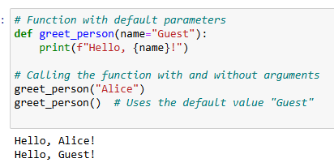
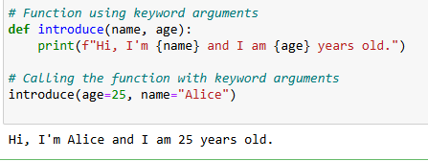
3. Returning Values from Functions
A function can return a value using the return keyword. This allows the function to pass data back to the caller.
4. Default Parameters
You can assign default values to function parameters. If the caller doesn't provide an argument for a parameter, the default value will be used.

Slide 30
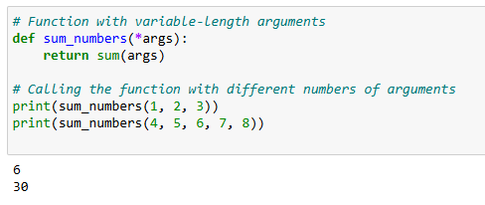
5. Variable-Length Arguments
You can define functions that accept an arbitrary number of arguments using *args (for non-keyword arguments) or **kwargs (for keyword arguments).

Slide 31

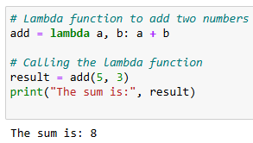


6. Lambda Functions (Anonymous Functions)
A lambda function is a small anonymous function.
A lambda function can take any number of arguments, but can only have one expression.

Slide 32
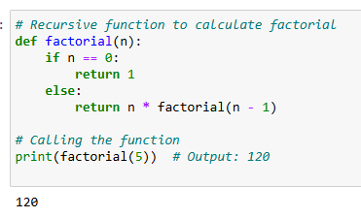
7. Recursive Functions
A recursive function is a function that calls itself. It is typically used to solve problems that can be broken down into smaller sub-problems.

Slide 33
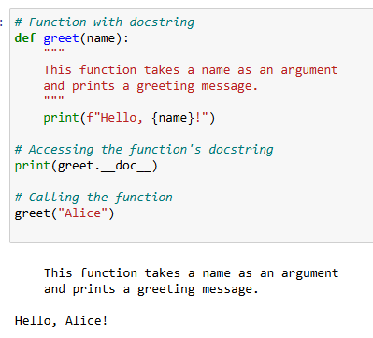
8. Function Documentation (Docstrings)
You can document your functions using docstrings, which are written in triple quotes.
These provide a description of what the function does.

Slide 34
Summary of Key Concepts of Functions:
def: Defines a function in Python.
Parameters: The values passed to a function when calling it.
Return: A function can return a value using the return keyword.
Default Parameters: Parameters that have default values if no argument is passed.
Keyword Arguments: Passing arguments by their names.
*args: A way to pass a variable number of positional arguments.
**kwargs: A way to pass a variable number of keyword arguments.
Lambda Functions: Anonymous functions for simple operations.
Recursion: Functions calling themselves to solve problems.
Docstrings: Documenting functions with descriptions for clarity.

Slide 35
5.Jupyter Notebook
Introduction to Jupyter Notebook
Installing Jupyter Notebook
Launching Jupyter Notebook
Jupyter Notebook Interface
Headings
Common Shortcuts

Slide 36
Introduction to Jupyter Notebook:
Jupyter Notebook is an open-source web application that allows you to create and share documents that contain live code, equations, visualizations, and narrative text.
It is widely used in data science, machine learning, academic research, and teaching.
Jupyter stands for Julia, Python, and R, the three languages it initially supported. However, Jupyter now supports many other languages as well.
Installing Jupyter Notebook
To use Jupyter Notebooks, you need to install them. Here are two common ways to install Jupyter:
→Using pip (Python's Package Installer)
If you already have Python installed, you can install Jupyter Notebook with pip:
pip install notebook
→Using Anaconda Distribution
The Anaconda Distribution includes Jupyter Notebook and many other scientific libraries. If you have Anaconda installed, Jupyter Notebook is already available

Slide 37
Launching Jupyter Notebook
Once installed, you can launch Jupyter Notebook:
→From the Command Line (Terminal or CMD): Open your terminal or command prompt and type: jupyter notebook
This will open the Jupyter Notebook interface in your default web browser at http://localhost:8888.
→From Anaconda Navigator: If using Anaconda, you can launch Jupyter from the Anaconda Navigator by clicking on "Launch" under the Jupyter Notebook section.
Jupyter Notebook Interface
When you launch Jupyter, you are taken to the dashboard, which is essentially a file browser. Here are the main parts of the interface:
File Browser: Shows the contents of your working directory. From here, you can open, create, and manage notebooks.
New Button: Click the "New" button to create a new notebook with a specific kernel (e.g., Python 3).
Notebook File (.ipynb): Files you create or open are Jupyter Notebooks, with a .ipynb extension.

Slide 38
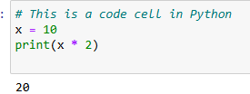
Notebook Cells
Jupyter Notebooks consist of cells. The two most common types of cells are:
Code Cells: These cells contain Python code or code from another language. You can execute the code in a cell and view the output directly below it.
Example of Code Cell:
Markdown Cells: These cells allow you to add rich text using Markdown syntax. Markdown is a lightweight markup language used for formatting text, including headings, lists, links, and images.
Markdown Formatting in Jupyter Notebooks
Markdown is used for text formatting. Here’s how to format your text:
Text Formatting
Bold: **bold** or __bold__
Italic: *italic* or _italic_
Bold and Italic: ***bold and italic***
Strikethrough: ~~strikethrough~~

Slide 39
Headings
You can create headings by using hash symbols (#). The number of # symbols determines the size of the heading (from H1 to H6).
# Heading 1
## Heading 2
### Heading 3
#### Heading 4
##### Heading 5
###### Heading 6
Common Shortcuts
Shift + Enter: Run the current cell and move to the next.
Ctrl + Enter: Run the current cell but stay on it.
Esc: Enter command mode.
Enter: Enter edit mode.
A: Insert a new cell above.
B: Insert a new cell below.
DD: Delete the current cell.

Slide 40
6.Introduction to Pandas:
Key Features of Pandas:
Pandas Data Structures
Series
DataFrame
Basic Operations with DataFrame
Accessing Columns
Accessing Rows
Filtering Data
Data Cleaning and Transformation
Handling Missing Data
Renaming Columns
Merging and Joining DataFrames
GroupBy Operations:
Exporting Data

Slide 41
6.Introduction to Pandas:
Pandas is a powerful and widely-used Python library for data manipulation and analysis. It provides two main data structures: Series and DataFrame, which are essential for working with structured data, such as spreadsheets, CSV files, or databases. Pandas is built on top of other scientific libraries like NumPy and Matplotlib, making it an essential tool for data analysis and data science.
Key Features of Pandas:
DataFrames: A table-like structure where rows represent data points and columns represent variables.
Series: A one-dimensional labeled array that can store any data type (integers, strings, floats, etc.).
Data cleaning: Handle missing data, duplicates, and data transformation.
Data manipulation: Filter, sort, group, and aggregate data.
Merging and joining: Combine multiple datasets based on common columns or indexes.
Time Series: Special features for working with time-based data.
Installing Pandas
Before using Pandas, you need to install it. You can do so with pip:
pip install pandas
Importing Pandas
Once installed, you can import Pandas into your Python script:
import pandas as pd

Slide 42
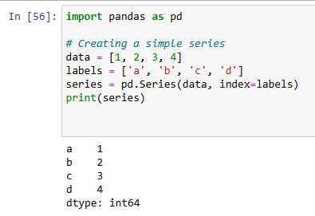
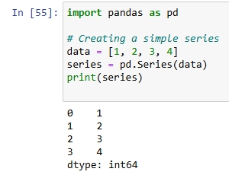
Pandas Data Structures
a) Series
A Series is a one-dimensional array with labeled axes (index). It is similar to a column in a spreadsheet or a single column of a DataFrame.
You can also provide custom labels (index):

Slide 43
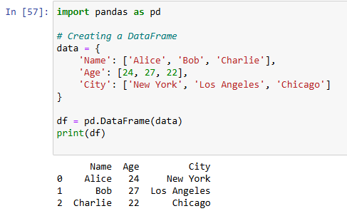
b) DataFrame
A DataFrame is a two-dimensional, size-mutable, and potentially heterogeneous tabular data structure with labeled axes (rows and columns). You can think of it as a table.

Slide 44
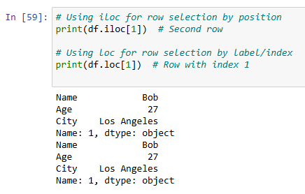
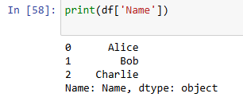
Basic Operations with DataFrame
a) Accessing Columns
You can access columns using their names:
b) Accessing Rows
You can use .loc[] for label-based indexing or .iloc[] for integer-based indexing.

Slide 45
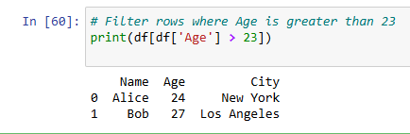
Basic Operations with DataFrame
c) Filtering Data
You can filter rows based on conditions.

Slide 46
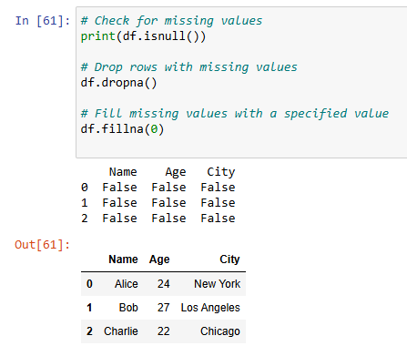
Data Cleaning and Transformation
a) Handling Missing Data
Pandas provides several methods for handling missing data. You can check for missing values and either remove or replace them.

Slide 47
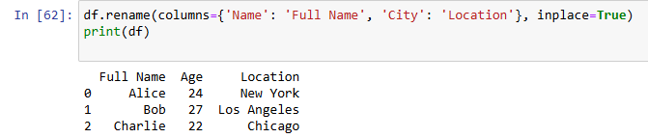
b) Renaming Columns
To rename columns, use the rename() function:

Slide 48
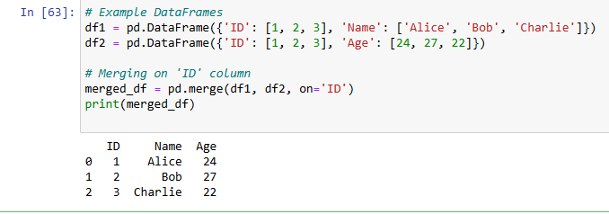
Merging and Joining DataFrames: Pandas allows merging and joining DataFrames in various ways. The merge() function is often used to combine datasets.

Slide 49
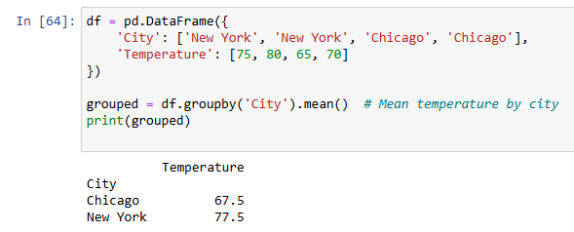
GroupBy Operations: You can group data based on one or more columns and perform operations like aggregation.

Slide 50
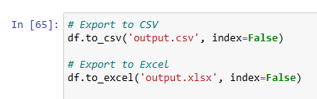
Exporting Data
Once you've manipulated your data, you can export it to various formats like CSV, Excel, or SQL.
Conclusion
Pandas is a versatile library that can help you clean, manipulate, and analyze data efficiently.
With its powerful data structures, such as Series and DataFrame, combined with various methods for data manipulation and analysis, you can handle almost any data science or data analysis task.

Slide 51
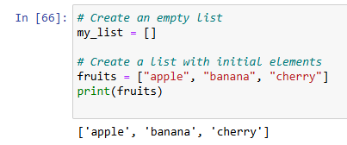
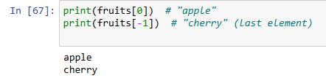
7.Python Data Structures
Python provides several built-in data structures that allow you to store and manage collections of data in an organized manner. The main Python data structures include lists, tuples, sets, and dictionaries. These structures are essential for various tasks such as data manipulation, collection management, and algorithm development.
Lists (Ordered, Mutable)
A list is an ordered collection of items that can hold elements of any data type (integers, strings, objects, etc.). Lists are mutable, meaning you can modify their contents after creation.
Creating a List:
List Operations
Accessing Elements: Use indices to access elements (indexing starts at 0).

Slide 52

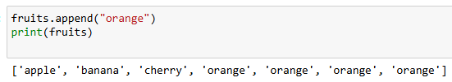

Slicing: You can slice a list to get a subset of elements
Appending: Add elements to the end of the list
.
Inserting: Insert an element at a specific index

Slide 53
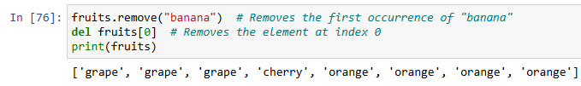

Removing: Remove an element by value or index.
List Length: Get the number of elements in a list.

Slide 54
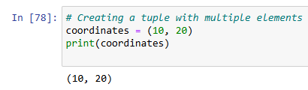


Tuples (Ordered, Immutable):A tuple is similar to a list but is immutable, meaning once created, its contents cannot be changed.
Creating a Tuple:
Tuple Operations:Accessing Elements: Just like lists, you can access elements using indices.
Concatenation: You can concatenate tuples to create a new one.

Slide 55


Repetition: You can repeat the elements of a tuple.
Length: Get the number of elements in a tuple.

Slide 56
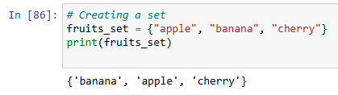
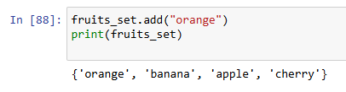
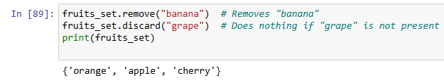
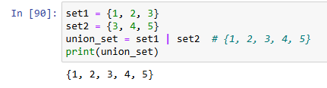
3. Sets (Unordered, Mutable, No Duplicates)
A set is an unordered collection of unique elements. Sets are mutable, meaning you can add or remove elements, but duplicates are not allowed.
Set Operations:Adding Elements: You can add elements to a set.
Removing Elements: Use remove() or discard() to remove elements.
Union: Combine two sets to get a new set with all unique elements.

Slide 57
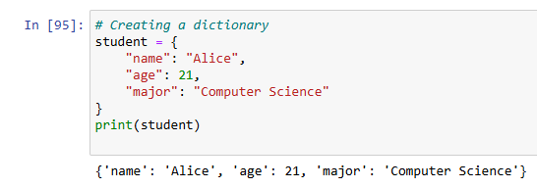


Intersection: Get common elements between two sets.
Difference: Get elements that are in one set but not the other.
4. Dictionaries (Unordered, Mutable, Key-Value Pairs)
A dictionary is a collection of key-value pairs. Each key must be unique, and it maps to a corresponding value. Dictionaries are mutable, so you can add, modify, or delete key-value pairs.
Creating a Dictionary

Slide 58

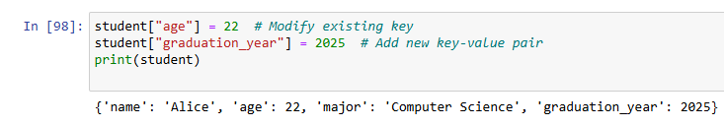
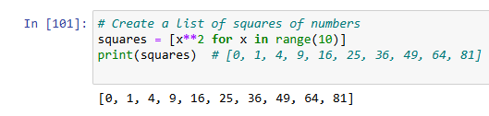
Dictionary Operations
Accessing Values: Use keys to access values
Adding or Modifying Key-Value Pairs:
Removing Elements:
You can remove key-value pairs using del or pop()
5. Advanced Operations
a) List Comprehensions
List comprehensions provide a concise way to create lists.

Slide 59
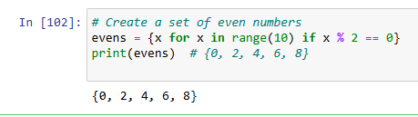
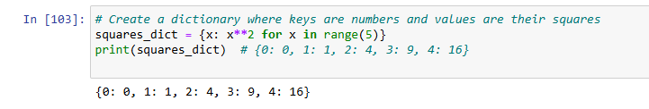
b) Set Comprehensions: Similar to list comprehensions, but for sets.
c) Dictionary Comprehensions: Create dictionaries with comprehensions.

Slide 60
6. Choosing the Right Data Structure
Lists are best when you need to store ordered data or need to allow duplicate values.
Tuples are ideal when you want to store immutable data.
Sets are perfect for storing unique items and performing set operations.
Dictionaries are best when you need to store key-value pairs and require fast lookups by keys.
Conclusion
Understanding Python's built-in data structures is crucial for efficient programming. These data structures are foundational to managing and processing data effectively. Whether you're working with simple lists or need the power of dictionaries, mastering these structures will make you more proficient at solving problems and writing efficient code.

Slide 61
8.Essential functionality:
Basic Syntax and Data TypesVariables
Data Types:
Type Casting:
Control FlowConditionals: if, elif, else statements.
Loops: for and while loops for iteration.
Break, Continue: Control loop flow.
FunctionsDefining Functions: Reusable blocks of code
Lambda Functions:
Arguments:
Error HandlingExceptions: try, except, else, and finally blocks.
File I/OReading and Writing Files: Using open() to interact with files.
Data Structures
Modules and Libraries
Object-Oriented Programming (OOP)
Inheritance
Polymorphism
Encapsulation
Abstraction

Slide 62
8.Essential functionality:
Essential functionality refers to the core features, built-in functions, libraries, and structures that are foundational to writing effective Python code. Below is an overview of some of the key functionalities that every Python programmer should be familiar with:
1. Basic Syntax and Data TypesVariables: Storing values like numbers, strings, lists, etc.
x = 10 # Integer
name = "John" # String
Data Types: Common types like integers, floats, strings, lists, tuples, sets, and dictionaries.
num = 5 # int
pi = 3.14 # float
fruits = ["apple", "banana", "cherry"] # list
person = {"name": "John", "age": 30} # dictionary
Type Casting: Converting one type to another.
x = int("10") # Convert string to integer
y = str(10) # Convert integer to string

Slide 63
2. Control FlowConditionals: if, elif, else statements.
if x > 10:
print("x is greater than 10")
elif x == 10:
print("x is equal to 10")
else:
print("x is less than 10")
Loops: for and while loops for iteration.
for fruit in fruits:
print(fruit)
i = 0
while i < 5:
print(i)
i += 1

Slide 64
Break, Continue: Control loop flow.
for i in range(10):
if i == 5:
break # Exit the loop
if i == 3:
continue # Skip the rest of the loop for i == 3
print(i)
3. FunctionsDefining Functions: Reusable blocks of code
def greet(name):
return f"Hello, {name}!"
print(greet("Alice"))

Slide 65
Lambda Functions: Anonymous functions for short operations.
add = lambda x, y: x + y
print(add(2, 3)) # Outputs 5
Arguments: Positional, keyword, and default arguments.
def greet(name="Guest", age=25):
print(f"Hello {name}, you are {age} years old.")
greet() # Uses default values
greet(name="Alice") # Uses default age
4. Error HandlingExceptions: try, except, else, and finally blocks.
try:
x = 10 / 0
except ZeroDivisionError:
print("Cannot divide by zero!")
else:
print("Division successful!")
finally:
print("This will always execute.")

Slide 66
5. File I/OReading and Writing Files: Using open() to interact with files.
# Writing to a file
with open("example.txt", "w") as f:
f.write("Hello, Python!")
# Reading from a file
with open("example.txt", "r") as f:
content = f.read()
print(content)
6. Data Structures
Lists: Ordered, mutable collection.;
numbers = [1, 2, 3, 4]
numbers.append(5)
Tuples: Immutable collection. ;point = (10, 20)
Dictionaries: Key-value pairs.
person = {"name": "John", "age": 30}
person["location"] = "New York"
Sets: Unordered, no duplicates.
unique_numbers = {1, 2, 3, 3, 4}

Slide 67
7. Modules and Libraries
Importing Modules: Using libraries to extend functionality.
import math
print(math.sqrt(16)) # Outputs 4.0
Standard Libraries: Python has many built-in libraries, including:
math, random, datetime, os, sys, etc.
collections, itertools, functools, etc.
Object-Oriented Programming (OOP)
Classes and Objects: Encapsulation of data and behavior.
class Dog:
def __init__(self, name, age):
self.name = name
self.age = age
def bark(self):
return f"{self.name} says Woof!"
dog1 = Dog("Rex", 3)
print(dog1.bark())

Slide 68
Inheritance: Creating a new class from an existing class.
class Animal:
def speak(self):
return "Animal sound"
class Dog(Animal):
def speak(self):
return "Woof!"
dog = Dog()
print(dog.speak())
Polymorphism: Method overriding and dynamic behavior.
Encapsulation: Hiding internal states (using private variables).
Abstraction: Simplifying complex systems by abstracting certain details.

Slide 69
8.Measures of Central Tendency & Dispersion
Central Tendency includes:
Mean: The average of the data.
Median: The middle value when data is sorted.
Mode: The most frequent value
Measures of Dispersion
Dispersion includes
Range: Difference between maximum and minimum values.
Variance: The average of squared deviations from the mean.
Standard Deviation: Square root of the variance.
IQR (Interquartile Range): Spread of the middle 50% of the data.
Summary Table

Slide 70
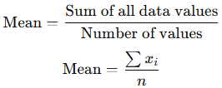


1.Central Tendency:
Central tendency is a statistical measure that identifies a single value as representative of an entire dataset.
It provides an idea of where the "center" of the data lies.
The three main measures of central tendency are:
Mean (Arithmetic Average)
Median (Middle Value)
Mode (Most Frequent Value)
1.1 Mean
The mean is the sum of all values divided by the number of values. Formula:
Example:
For data: 5,10,15,205, 10, 15, 205,10,15,20
Use Case: Mean works well for normally distributed data but can be affected by outliers.

Slide 71

1.2 Median
The median is the middle value when the data is arranged in ascending or descending order.
Steps to Calculate Median:
Sort the data:
If nnn (number of values) is odd, the median is the middle value.
If nnn is even, the median is the average of the two middle values.
Use Case: Median is robust to outliers and skewed data.

Slide 72
1.3 Mode:
The mode is the value that appears most frequently in the dataset.
Example:
For data: 2,3,3,4,5,5,5,62, 3, 3, 4, 5, 5, 5, 62,3,3,4,5,5,5,6 Mode = 5 (appears most often).
A dataset can have:
No mode (if no value repeats).
One mode (unimodal).
Two modes (bimodal).
Multiple modes (multimodal).
Use Case: Mode is useful for categorical or discrete data.

Slide 73
2. Dispersion
Dispersion measures the spread or variability of data. It tells us how far the values are distributed from the central tendency.
The four main measures of dispersion are:
Range
Variance
Standard Deviation
Interquartile Range (IQR)
2.1 Range
The range is the difference between the maximum and minimum values.
Formula: Range=Maximum value−Minimum value
Example: For data: 3,5,7,12,20,3, 5, 7, 12, 203,5,7,12,20
Range=20−3=17
Use Case: Range is simple but sensitive to outliers.

Slide 74





2.2 Variance
Variance measures the average squared deviation from the mean.
Formulas:
For a population with N data points: For a sample with n data points::

Slide 75


Slide 76


Slide 77

Real-World Applications
Central Tendency: Used to summarize data like average income, grades, or test scores.
Dispersion: Helps measure risk in finance, variability in manufacturing, or spread in weather temperatures.

Slide 78
9.Visual Representation of the Data
Visual representation helps in
libraries for data visualization:
Matplotlib: Basic visualization.
Seaborn: Statistical plotting.
Pandas: Quick plots from dataframes.
Plotly: Interactive visualizations.
Setting Up Libraries
Visualizations in Python
Line Plot:
Bar Plot
Histogram
Box Plot
Scatter Plot
Pair Plot
Heatmap
Combining Multiple Plots
Choosing the Right Visualization
Real-World Example: Visualizing a Dataset
→Refer Pdf for detailed explanation

Slide 79
UNIT- I :: Covered Topics
Part-1 | Part-2 | Part-3
0.Introduction to Data Analytics: Data and its importance Data analytic and its types Importance of data analytics | Python Fundamentals: Python Language Basics Jupyter Notebook Introduction to pandas Data Structures Essential Functionality | Central Tendency and Dispersion: Visual Representation of the Data Measures of Central Tendency Dispersion

